Slide 1

Thank You
This PowerPoint document contains the images that you requested.
Copyright Notice
All Online Service materials, including, without limitation, text, pictures, graphics and other files and the selection and arrangement thereof are copyrighted materials of Ovid or its licensors, all rights reserved. Except for the Authorized Use specified above, you may not copy, modify or distribute any of the Online Service materials. You may not "mirror" any material contained on this Online Service on any other server. Any unauthorized use of any material contained on this Online Service may violate copyright laws, trademark laws, the laws of privacy and publicity and communications regulations and statutes.

Slide 2

Equation U1
Validation of Population Pharmacokinetic Parameters of Phenytoin Using the Parallel Michaelis-Menten and First-Order Elimination Model.
Valodia, Praneet; Seymour, Michael; McFadyen, Margaret; Miller, Raymond; Folb, Peter
Therapeutic Drug Monitoring. 22(3):313-319, June 2000.
Equation U1
© 2000 Lippincott Williams & Wilkins, Inc. Published by Lippincott Williams & Wilkins, Inc.
2

Slide 3

Equation U2
Validation of Population Pharmacokinetic Parameters of Phenytoin Using the Parallel Michaelis-Menten and First-Order Elimination Model.
Valodia, Praneet; Seymour, Michael; McFadyen, Margaret; Miller, Raymond; Folb, Peter
Therapeutic Drug Monitoring. 22(3):313-319, June 2000.
Equation U2
© 2000 Lippincott Williams & Wilkins, Inc. Published by Lippincott Williams & Wilkins, Inc.
3

Slide 4
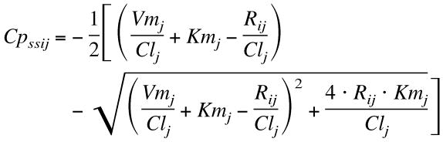
Equation U3
Validation of Population Pharmacokinetic Parameters of Phenytoin Using the Parallel Michaelis-Menten and First-Order Elimination Model.
Valodia, Praneet; Seymour, Michael; McFadyen, Margaret; Miller, Raymond; Folb, Peter
Therapeutic Drug Monitoring. 22(3):313-319, June 2000.
Equation U3
© 2000 Lippincott Williams & Wilkins, Inc. Published by Lippincott Williams & Wilkins, Inc.
4

Slide 5

Equation U4
Validation of Population Pharmacokinetic Parameters of Phenytoin Using the Parallel Michaelis-Menten and First-Order Elimination Model.
Valodia, Praneet; Seymour, Michael; McFadyen, Margaret; Miller, Raymond; Folb, Peter
Therapeutic Drug Monitoring. 22(3):313-319, June 2000.
Equation U4
© 2000 Lippincott Williams & Wilkins, Inc. Published by Lippincott Williams & Wilkins, Inc.
5

Slide 6
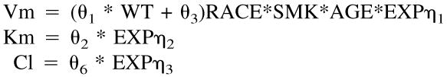
Equation U5
Validation of Population Pharmacokinetic Parameters of Phenytoin Using the Parallel Michaelis-Menten and First-Order Elimination Model.
Valodia, Praneet; Seymour, Michael; McFadyen, Margaret; Miller, Raymond; Folb, Peter
Therapeutic Drug Monitoring. 22(3):313-319, June 2000.
Equation U5
© 2000 Lippincott Williams & Wilkins, Inc. Published by Lippincott Williams & Wilkins, Inc.
6

Slide 7
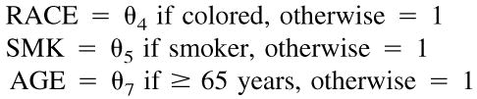
Equation U6
Validation of Population Pharmacokinetic Parameters of Phenytoin Using the Parallel Michaelis-Menten and First-Order Elimination Model.
Valodia, Praneet; Seymour, Michael; McFadyen, Margaret; Miller, Raymond; Folb, Peter
Therapeutic Drug Monitoring. 22(3):313-319, June 2000.
Equation U6
© 2000 Lippincott Williams & Wilkins, Inc. Published by Lippincott Williams & Wilkins, Inc.
7

Slide 8
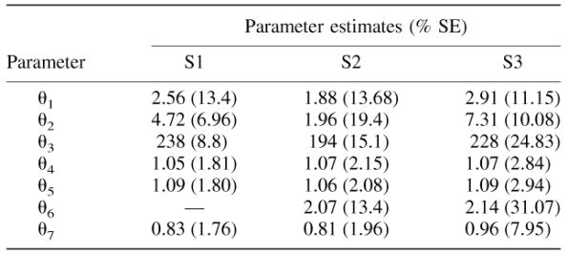
TABLE 1.
Validation of Population Pharmacokinetic Parameters of Phenytoin Using the Parallel Michaelis-Menten and First-Order Elimination Model.
Valodia, Praneet; Seymour, Michael; McFadyen, Margaret; Miller, Raymond; Folb, Peter
Therapeutic Drug Monitoring. 22(3):313-319, June 2000.
TABLE 1. Average parameter estimates for Groups 1 and 2 obtained for models S1, S2 and S3
© 2000 Lippincott Williams & Wilkins, Inc. Published by Lippincott Williams & Wilkins, Inc.
8

Slide 9
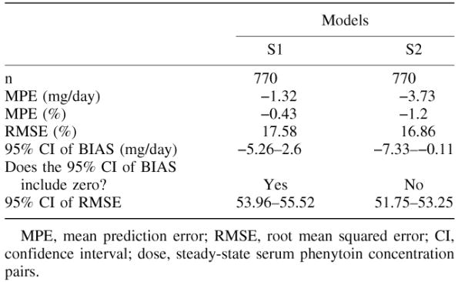
TABLE 2.
Validation of Population Pharmacokinetic Parameters of Phenytoin Using the Parallel Michaelis-Menten and First-Order Elimination Model.
Valodia, Praneet; Seymour, Michael; McFadyen, Margaret; Miller, Raymond; Folb, Peter
Therapeutic Drug Monitoring. 22(3):313-319, June 2000.
TABLE 2. Predictive performance evaluation of models S1 and S2MPE, mean prediction error; RMSE, root mean squared error; CI, confidence interval; dose, steady-state serum phenytoin concentration pairs.
© 2000 Lippincott Williams & Wilkins, Inc. Published by Lippincott Williams & Wilkins, Inc.
9

Slide 10
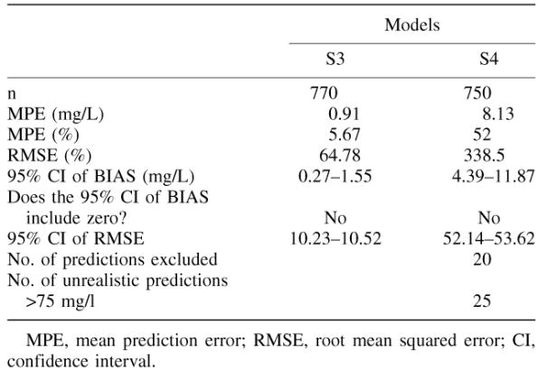
TABLE 3.
Validation of Population Pharmacokinetic Parameters of Phenytoin Using the Parallel Michaelis-Menten and First-Order Elimination Model.
Valodia, Praneet; Seymour, Michael; McFadyen, Margaret; Miller, Raymond; Folb, Peter
Therapeutic Drug Monitoring. 22(3):313-319, June 2000.
TABLE 3. Predictive performance evaluation of models S3 and S4MPE, mean prediction error; RMSE, root mean squared error; CI, confidence interval.
© 2000 Lippincott Williams & Wilkins, Inc. Published by Lippincott Williams & Wilkins, Inc.
10

Slide 11
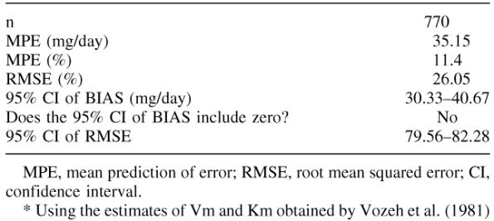
TABLE 4.
Validation of Population Pharmacokinetic Parameters of Phenytoin Using the Parallel Michaelis-Menten and First-Order Elimination Model.
Valodia, Praneet; Seymour, Michael; McFadyen, Margaret; Miller, Raymond; Folb, Peter
Therapeutic Drug Monitoring. 22(3):313-319, June 2000.
TABLE 4. Performance evaluation of the Michaelis-Menten model (S1) to predict phenytoin doseMPE, mean prediction of error; RMSE, root mean squared error; CI, confidence interval.*Using the estimates of Vm and Km obtained by Vozeh et al.(1981)
© 2000 Lippincott Williams & Wilkins, Inc. Published by Lippincott Williams & Wilkins, Inc.
11

Slide 12
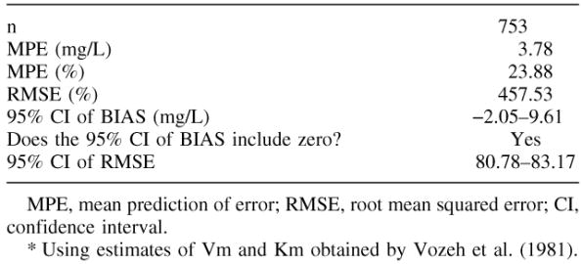
TABLE 5.
Validation of Population Pharmacokinetic Parameters of Phenytoin Using the Parallel Michaelis-Menten and First-Order Elimination Model.
Valodia, Praneet; Seymour, Michael; McFadyen, Margaret; Miller, Raymond; Folb, Peter
Therapeutic Drug Monitoring. 22(3):313-319, June 2000.
TABLE 5. Performance evaluation of the Michaelis-Menten model (S4) to predict serum phenytoin concentrationMPE, mean prediction of error; RMSE, root mean squared error; CI, confidence interval.*Using estimates of Vm and Km obtained by Vozeh et al. (1981).
© 2000 Lippincott Williams & Wilkins, Inc. Published by Lippincott Williams & Wilkins, Inc.
12

